Slide 1
CORE JAVA
Introduction part

Slide 2
What is java?
By now, you have understood how to represent algorithms in the form of pseudo-code and flowcharts to solve the given problem. But computers cannot understand and execute pseudo-code. To solve the given problem by computer, you need to write a program.
A program is a collection of instructions that performs a specific task when executed by a computer. A program must be written in a programming language.
Java has been evolving since 1991 with different editions
According to the TIOBE Programming Community Index, it has been one of the top 5 programming languages for the past several years
It is being used by more than 10 million developers worldwide
More than 15 billion devices are powered by Java technology
More than 125 million Java-based TV devices have been deployed
97% of enterprise desktops run Java

Slide 3
First java program
Welcome to java
class Welcome {
public static void main(String[] args) {
System.out.println("Hello World! Welcome to Java Programming!");
}
}

Slide 4
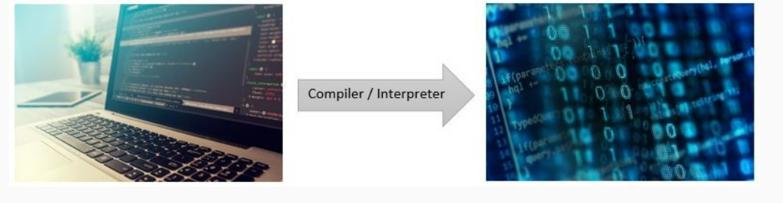
Java Environment: Compilation
We write programs in programming languages like Java which are called as High-level programming languages. But computers cannot understand high-level languages, they understand only binary language, i.e., 0's and 1's. This is the reason that every program that we write needs to get converted into binary form for the computer to understand.
This conversion is made possible using system software called compilers and interpreters.

Slide 5
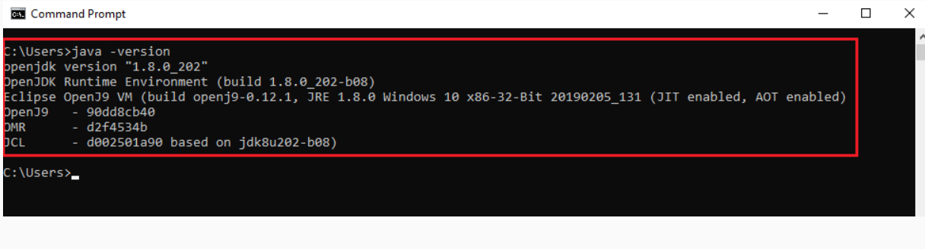
Java Installation
Please follow the below steps to check whether Java is installed on your computer.
Open command prompt and check if Java is installed in your computer using the following command
java -version
If Java is installed on your computer, you will get a message about the version installed on the command prompt window as shown below:

Slide 6
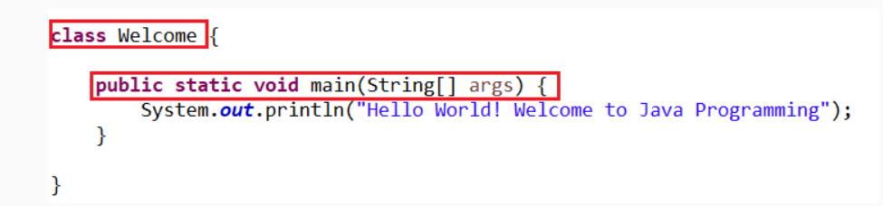
Understanding the program
The program displays a message - 'Hello World! Welcome to Java Programming!'. Here are some of the syntax rules of Java language:
The message is displayed using System.out.println which is used for displaying messages or output in Java.
Every statement in Java program must end with semicolon (;).
Every statement in Java must be present inside a method. A method is a block of code that performs a particular task.
In the code given above, the method is named as main. Every program in Java must have a main method as the code execution starts from the main method.
The method is defined using curly braces ({}). { signifies the start of a code block and } signifies its end.
Every method in Java must be present inside a class. In the code given above, the class is named as Welcome. You will learn about classes and methods in detail later in the course.
Java is a case-sensitive programming language. E.g. - The word class should be written in lower case.

Slide 7
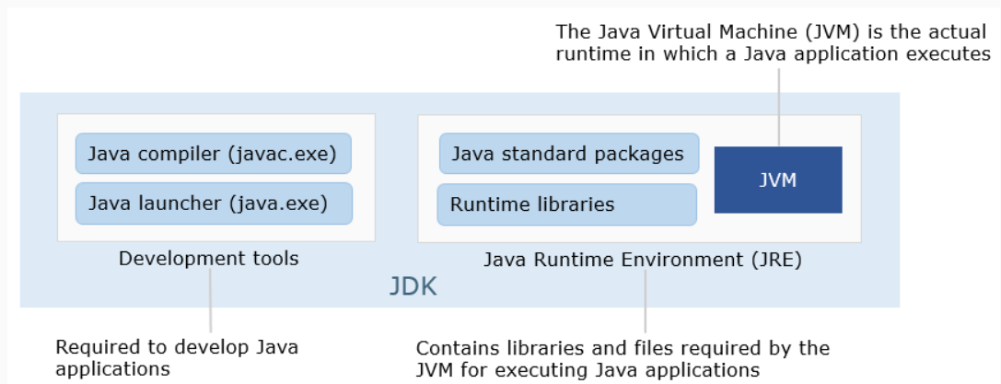
JDK in Detail
Java compiler (javac.exe) - It is the primary Java compiler. The compiler accepts Java source code and produces Java bytecode conforming to the Java Virtual Machine Specification (JVMS).
Java launcher (java.exe) - It helps in launching a Java application during execution.
The Java Runtime Environment (JRE) contains Java Virtual Machine(JVM) and the Java standard library (Java Class Library.
Java Virtual Machine (JVM) - It is the virtual machine that enables the computer to run Java programs.
Java standard library (Java Class Library) - It is a set of dynamically loadable libraries that Java applications can call at run time. Java Platform is not dependent on a specific operating system and hence applications cannot rely on any of the platform-native libraries.

Slide 8
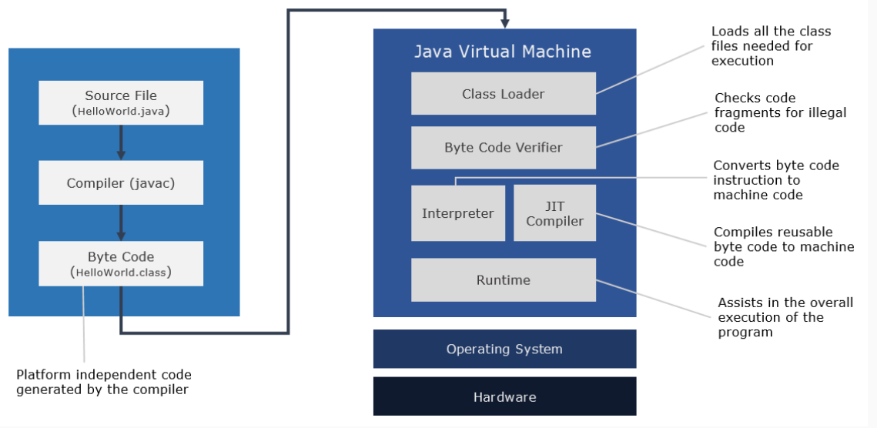
Execution of Java Program
The Java source code is saved in a file with .java extension.
When we compile a Java program (.java file), .class files (byte code) with the same class names present in .java file are generated by the Java compiler (javac).
These .class files go through various steps when we run the program as shown in the below diagram.

Slide 9
Platform Independent
If a program written on a particular platform can run on other platforms without any recompilation, it is known as a platform independent program.
While most of them could be working on the same operating system such as Windows, others might be using different operating systems like Mac or Linux. In this scenario, we might have a situation where a program written on Windows needs to be executed on Mac OS also.
Since Java is platform independent, it is not a problem. A program written using Java on Windows will execute without any recompilation on any other platform.

Slide 10
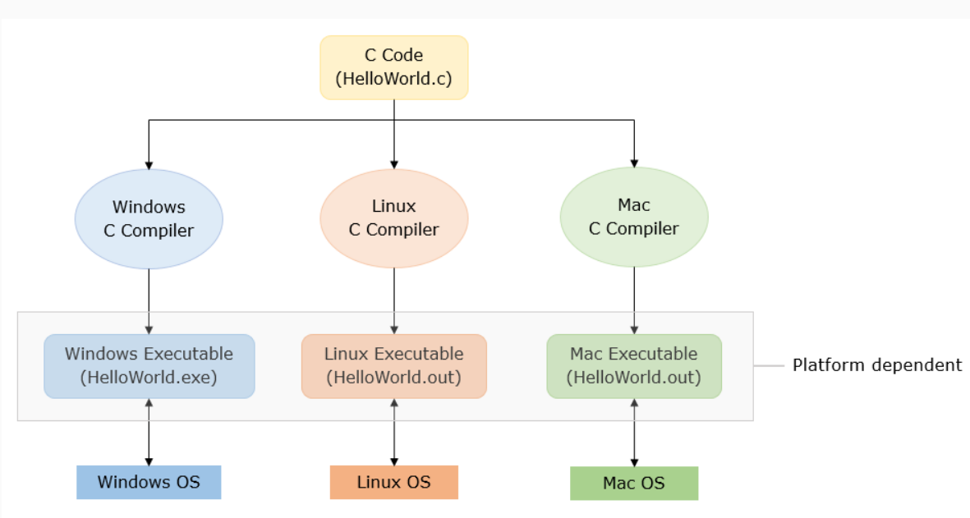
C- platform Dependent

Slide 11
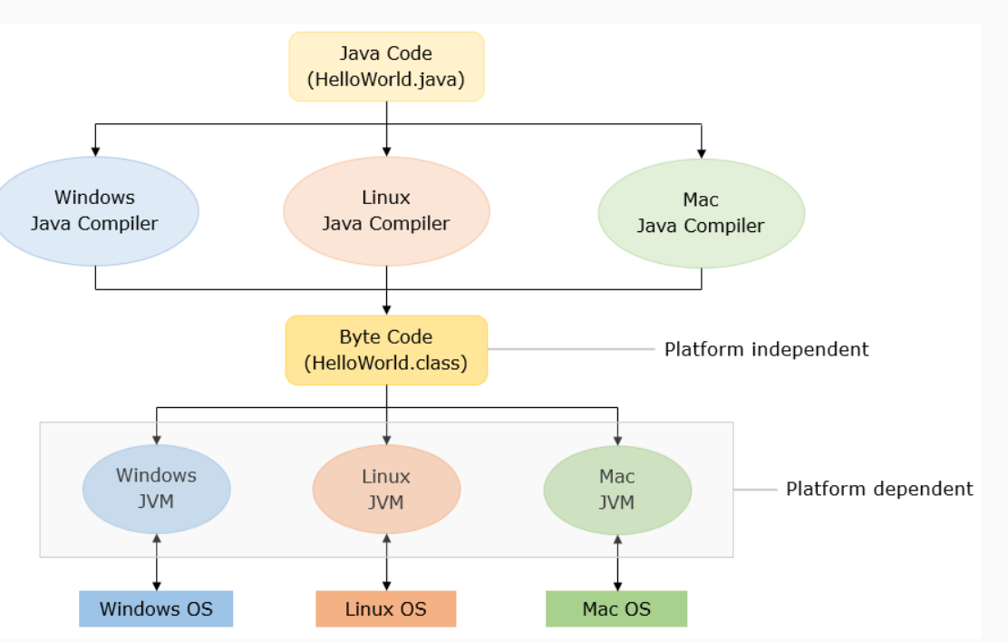
Java-platform independent

